Slide 1
AHI 507: Sports Data Analysis
Nina Barcelon, Blanca Chimborazo-Reyes, Luke Duggan, Equislaure Gabriel, Katiana Jean & Yatza Lo
Notes:
Blanca Notes: Good evening, everyone. I’m Blanca and this is my team’s sports data analysis.

Slide 2
Breakdown
Presentation Overview
AHI 507
01.
Introduction
02.
Methods
03.
Key Findings
04.
Practical Applications
05.
Limitations & Future work
Notes:
Blanca Notes: We’ll start off with an Introduction then we’ll dive into Methods, Key Findings, Practical Applications and finally, the Limitations we encountered and our recommendations for Future Work.

Slide 3
Introduction
Hypothesis, Research Question and Why:
Hypothesis: Would players with higher asymmetry differences between both sides for torque and max force affect acceleration load and distance total results?
Research Question: Could these key indicators be used to determine players' risk of injury?
Our Why: higher asymmetry differences between left and right-side measurements of torque and max force correlate with an increased risk of injury
Notes:
Blanca Notes: Our Hypothesis was: Would players with higher asymmetry differences between both sides for torque and max force affect acceleration load and distance total results?
This directed our research question which is: Could these key indicators be used to determine a player’s risk of injury?
This matters because multiple studies suggest that higher asymmetry differences between left and right-side measurements of torque and max force correlate with an increased risk of injury

Slide 4
Introduction
Selected Metrics and Why:
Vald: left and right Max Force, left and right Torque
Kinexon: Accumulated Acceleration Load and Total Distance (distance_total)
leftMaxForce (Newton N) - bilateral metric on force to determine player risk (Vald)
rightMaxForce (Newton N) - bilateral metric on force to determine player risk (Vald)
leftTorque (Newton-metres Nm)- bilateral metric on torque (Vald)
rightTorque (Newton-metres Nm) - bilateral metric on torque (Vald)
accel_load_accum - measure acceleration as it relates to total distance (Kinexon)
distance_total - to determine performance (Kinexon)
Notes:
Blanca Notes: To test our hypothesis, we observed left and right max force and torque from Vald as well as accel load accum and distance total from Kinexon
Max Force measures the absolute maximum linear force that a muscle or muscle group can produce
Torque measures the rotational force produced by a muscle group
Accel load accum, quantifies the total physical stress imposed by a player's repeated changes in velocity
And Total Distance measures the entire distance a player travels during a competition or training session
We decided on these metrics because they are widely used in assessing injury risk and player performance
By using these metrics, we were able to calculate asymmetry and then use the results in a linear regression analysis to look for correlations between these metrics

Slide 5

Introduction
Derived metrics and why
avg_MaxForce_asymmetry (Newton N): the difference of the asymmetrical analysis divided by the total symmetrical MaxForce multiplied by 100
avg_Torque_asymmetry (Newton-metres Nm): the difference of the asymmetrical analysis divided by the total symmetrical Torque multiplied by 100
MaxForce_asymmetry_category (High, Low)
Torque_asymmetry_category(High, Low)
An absolute value of asymmetrical percentage value to determine the category values between High and Low (greater than or equal to 10% is 'High,' less than 10% is 'Low.')
Notes:
Blanca Notes: Before we could conduct our analysis, we had to derive: Average Max Force Asymmetry and Average Torque Asymmetry to be able to quantify asymmetry
We used the formula pictured here, where L is the left-side and R is the right-side metric to calculate and derive asymmetry in Max Force and Torque
Finally, we used those average asymmetry values to create two categorical variables, those being MaxForce_asymmetry_category and Torque_asymmetry_category. An absolute asymmetrical percentage value greater than or equal to the 10% was designated as 'High,' and anything below that was considered 'Low.'

Slide 6
Methods
Data overview and quality assessment
Reviewed raw data to identify which metric has the most recorded values
Highlighted and omitted missing data
Recoded duplicate team names
Identified players assigned to multiple teams
Explored topics in PubMed relevant to the most-recorded metric
Notes:
Notes (Equislaure):
The methods used in this project included reviewing the raw data to determine which metric had the highest number of recorded values, highlighting and omitting missing data, and re-coding duplicate team names. The process also involved identifying players who were assigned to multiple teams. After determining the most frequently recorded metric, relevant topics in PubMed were explored to support the analysis.

Slide 7
Methods
Analysis approach
Conducted descriptive statistics (means, medians, ranges) to summarize the most-recorded metric
Used correlation and regression analyses to explore relationships between max force/torque and accumulated acceleration/distance
Cross-referenced findings with literature review to contextualize results
Notes:
Notes (Equislaure):
Descriptive statistics—including means, medians, and ranges—were then calculated to summarize this key metric. Correlation and regression analyses were conducted to examine the relationships between maximum force/torque and accumulated acceleration or distance. Finally, the findings were cross-referenced with the literature review to provide context and strengthen the interpretation of the results.

Slide 8
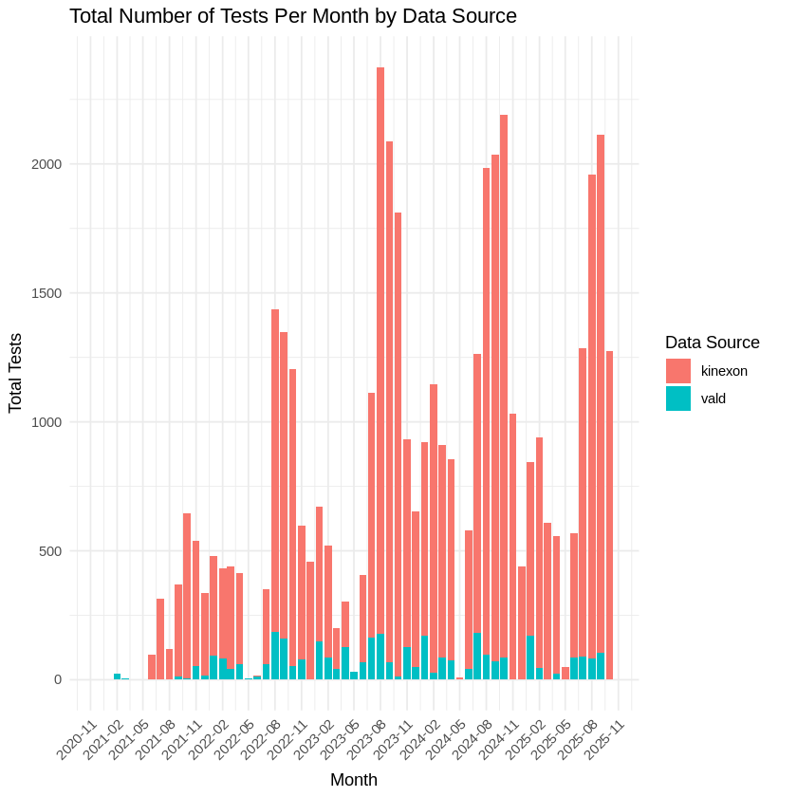
Key Findings
Main results with visualizations
Symmetrical metrics were recorded on a separate device (Vald) from non-symmetrical metrics for acceleration and distance using (Kinexon)
This limited our ability to match data sets and reduced our sample size.
Total Number of Tests Per Month (Kinexon and Vald)
Notes:
Slides 8-10 nina,slides 11-16 yatza
Regarding our key findings, symmetrical metrics such as torque and max force were recorded on the Vald device whereas acceleration and distance were recorded using kinexon. Primary issue seen across multiple teams is that there is a drastic difference in volume of testing between kinexon and vald device data. As seen on the chart on the left, Kinexon has more predominant volume of data compared to Vald.

Slide 9
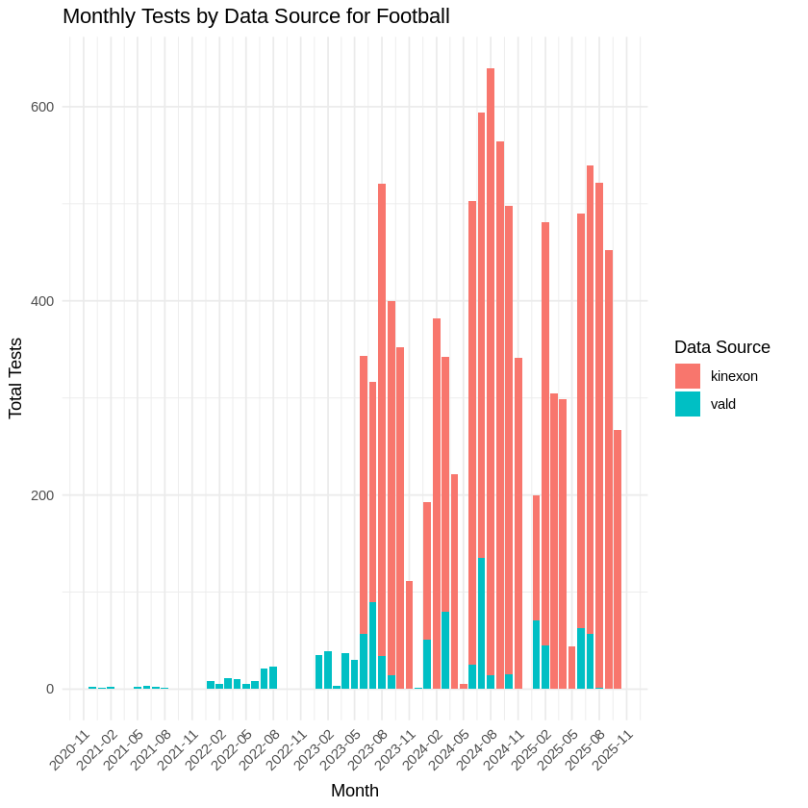
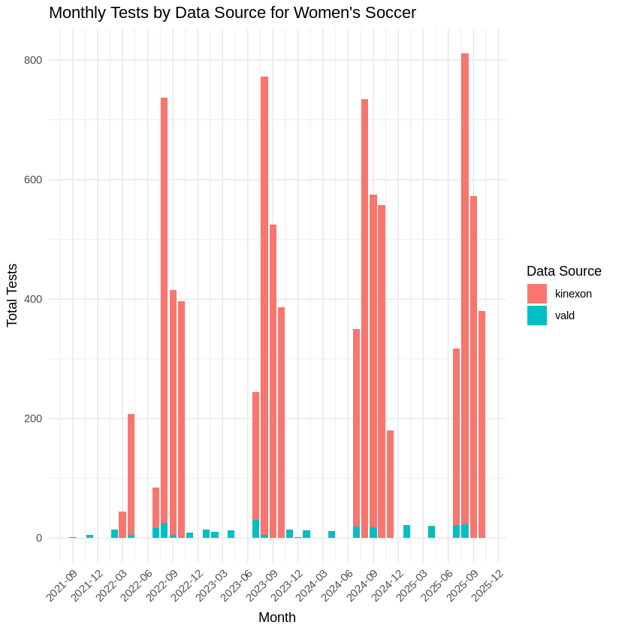
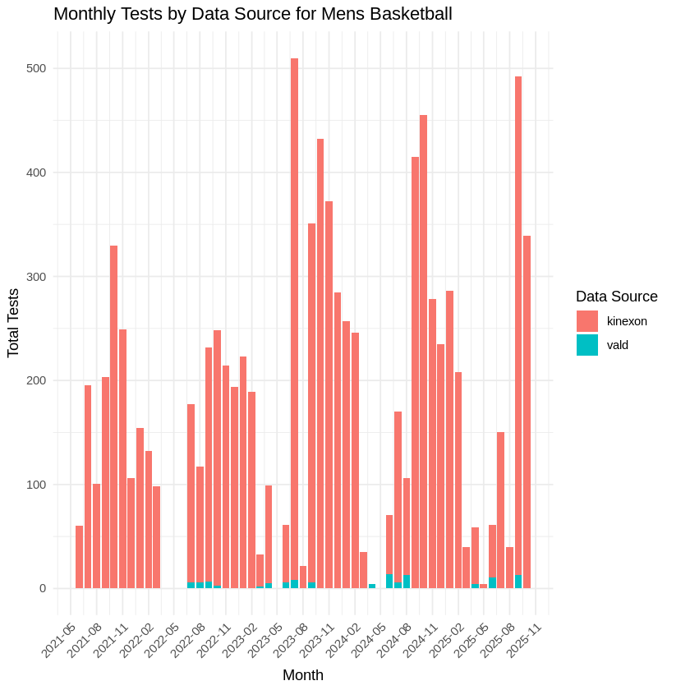
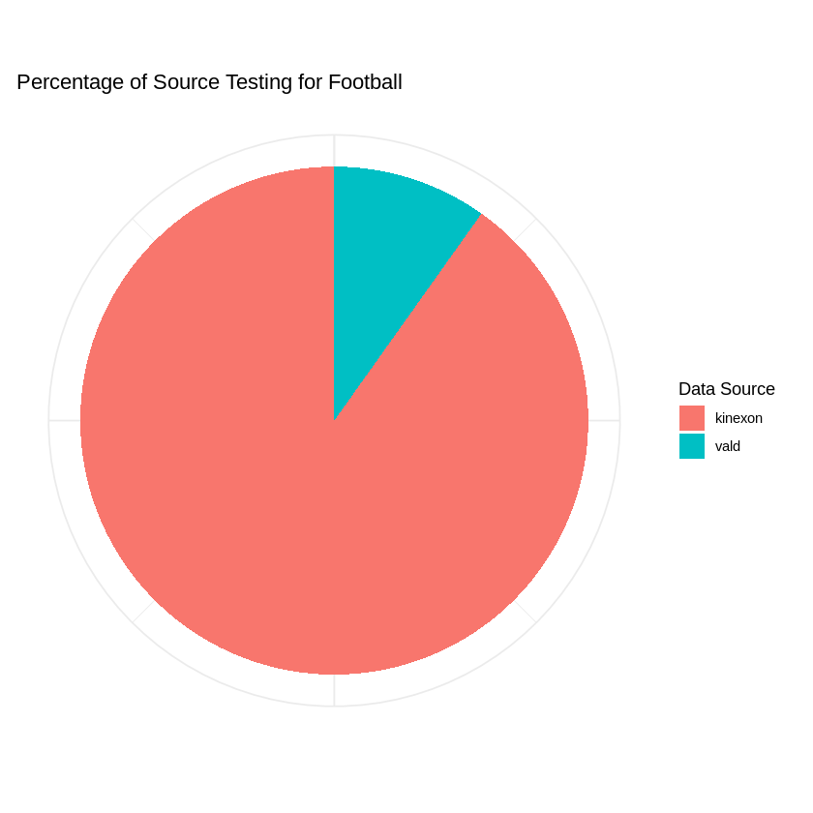
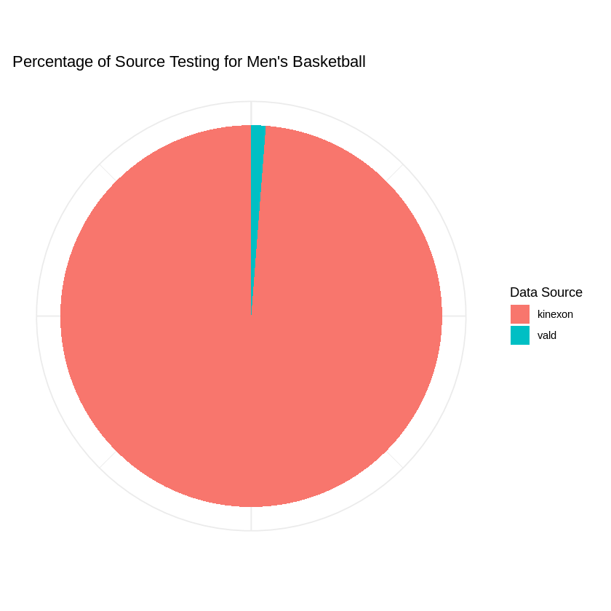
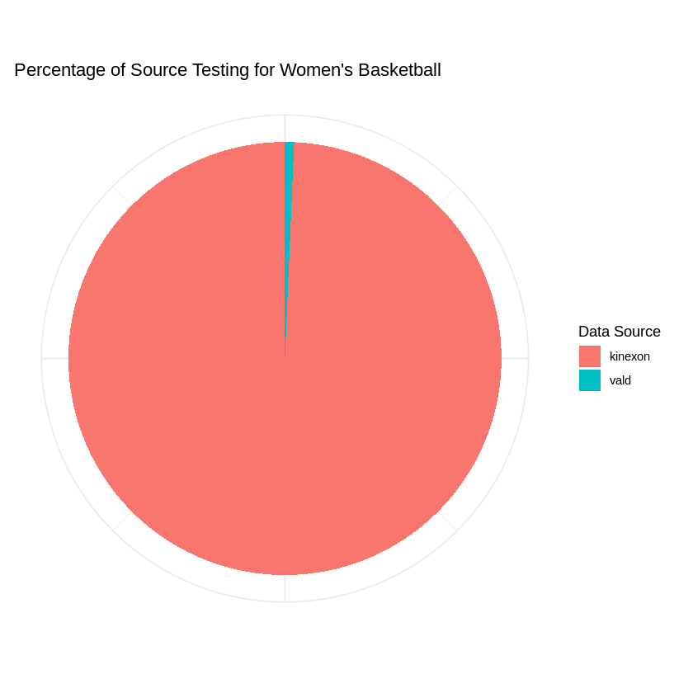
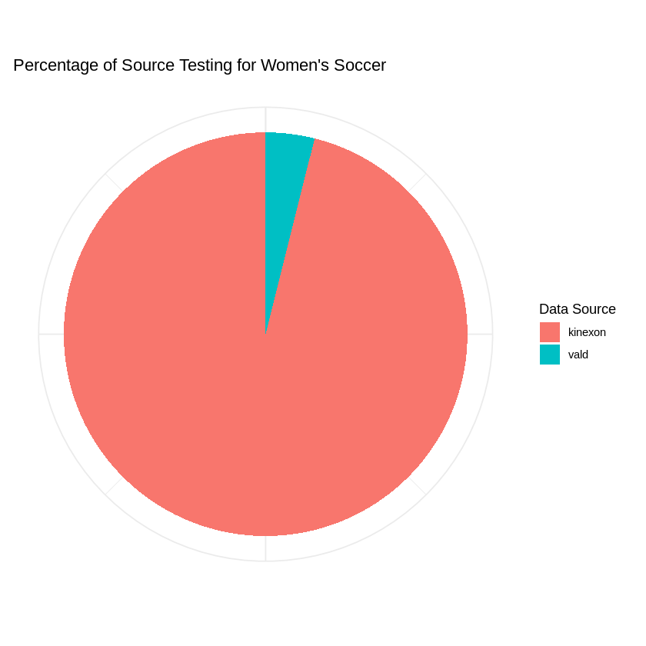
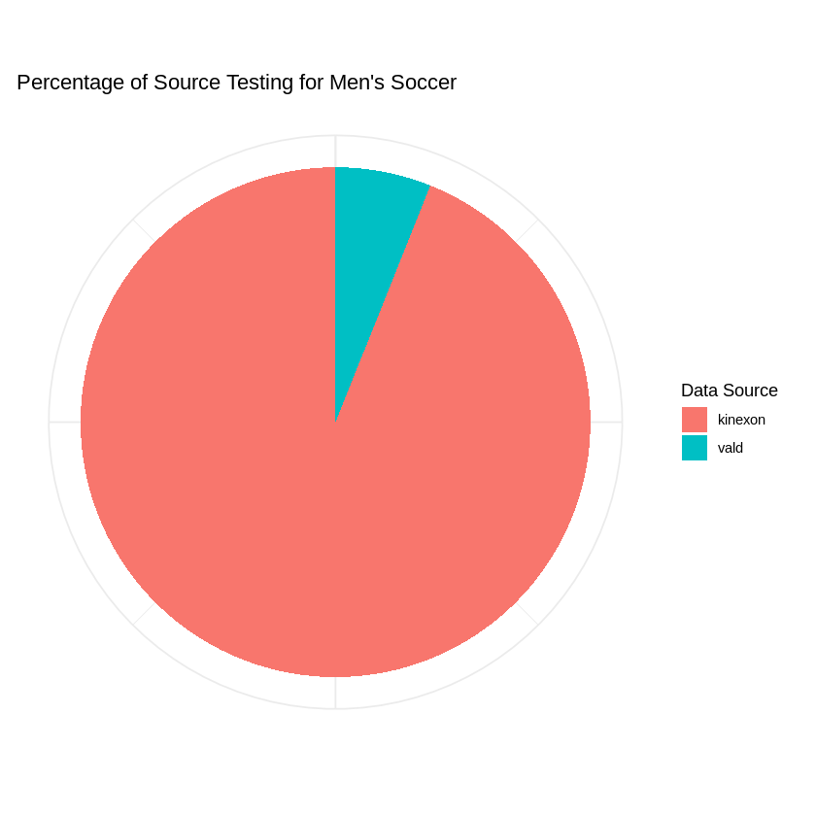
Key Findings
Testing Behaviors among teams
Team | Kinexon% | Vald %
Football | 90.2 | 9.84
Men’s Basketball | 98.8 | 1.22
Women’s Basketball | 99.3 | 0.674
Women’s Soccer | 96.1 | 3.9
Men’s Soccer | 93.9 | 6.03
Output for Kinexon data, “total_distance” and “accel_load”, are more frequently tested versus Vald data “Torque” and “Max_force”
Notes:
Difference in testing can also be seen amongst different teams with not just volume of device usage but also with testing behaviors of teams.
As shown above, Football has the highest use of Vald device across the top 5 primary teams and a higher ratio percentage of Vald data to Kinexon data. But as seen on monthly testing, football has most of its Vald data records during beginning of semesters.
However when compared to women’s soccer, women's soccer conducts more scheduled vald testing. However, key issue with women’s soccer testing behavior is that multiple instances with vald data are recorded without record of kinexon data. This would make it harder to determine correlation between Vald and Kinexon data metrics.
For men’s basketball, testing is slightly more sporadic but has a large amount of kinexon data values collected compared to vald data. Primary pattern is that there is a small amount of data collected for vald that occurs during the beginning of fall semester and at the end of spring semester.

Slide 10
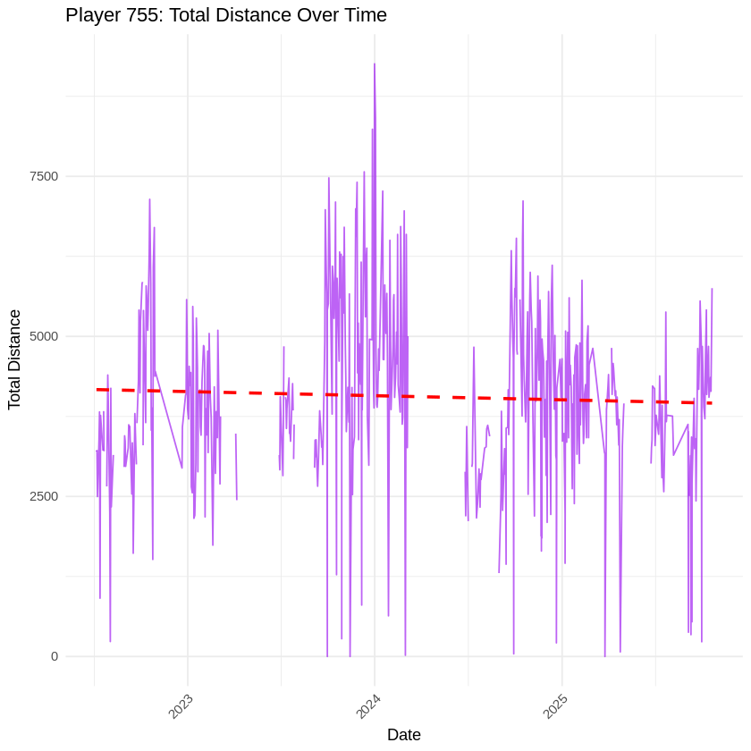
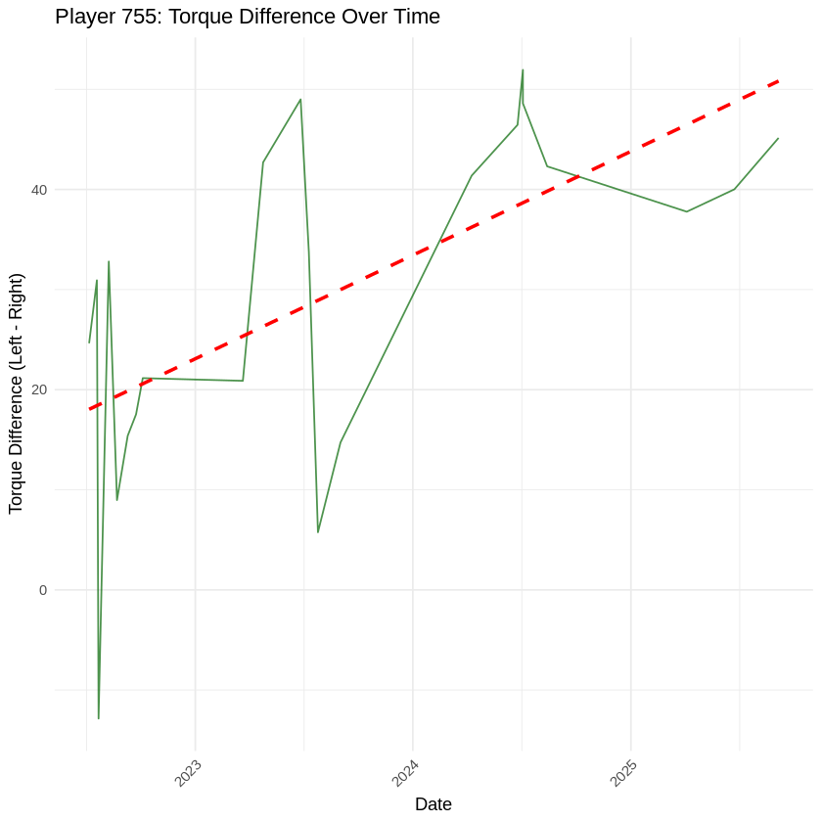
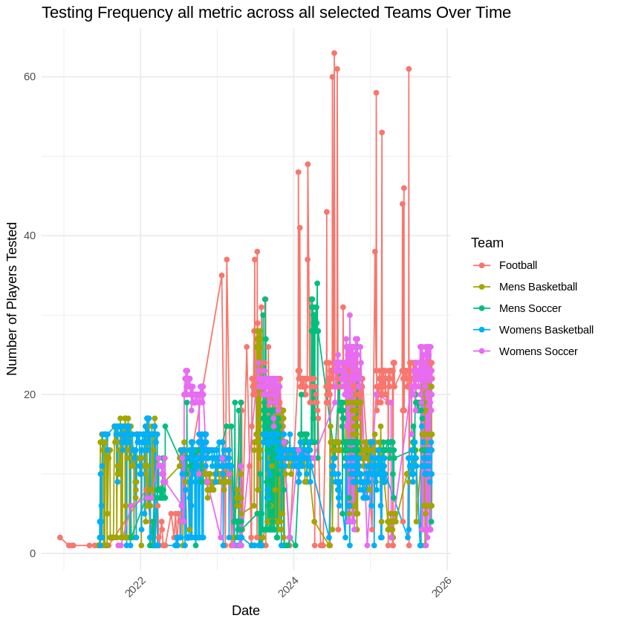
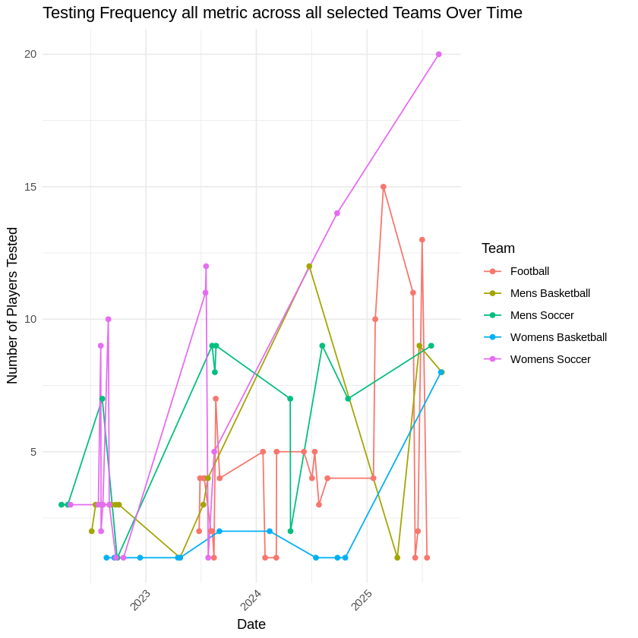
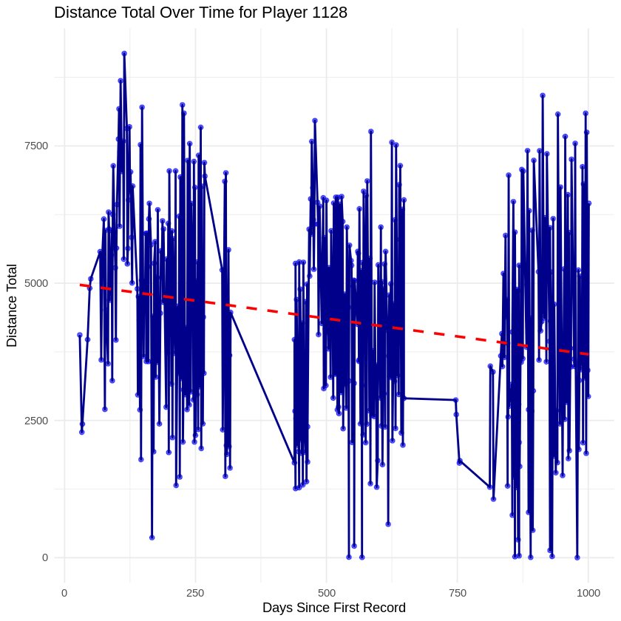
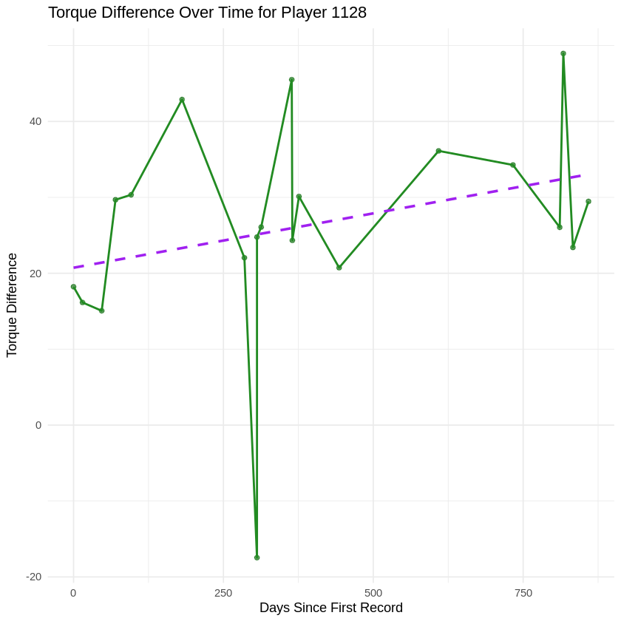
Key Findings
Main results with visualizations
A weak correlation was found between left and right max force and torque vs accumulated acceleration or distance for each player and team.
Notes:
When it comes to evaluation of player performance there is not enough Vald records to make correlation of data for Kinexon. As seen with players 1128 and players 755, total distance has consistent data but both players have infrequent torque data recordings.
Even though it appears that both total distance for both players decrease as difference in torque increases, this is relatively deceiving due to the lack of vald data and the incline variation. For example when you see player 755’s decline of total distance, it is very minimal when compared to the incline in torque difference overtime. As opposed to player 1128, there is a more pronounced decline in distance but a lower increased average of torque difference.
Similar issue can be see in testing frequency metric across all teams overtime where there is drastically fewer instances that have both vald and kinexon usage.
Next is Yatza covering statistical analysis of Key findings.

Slide 11
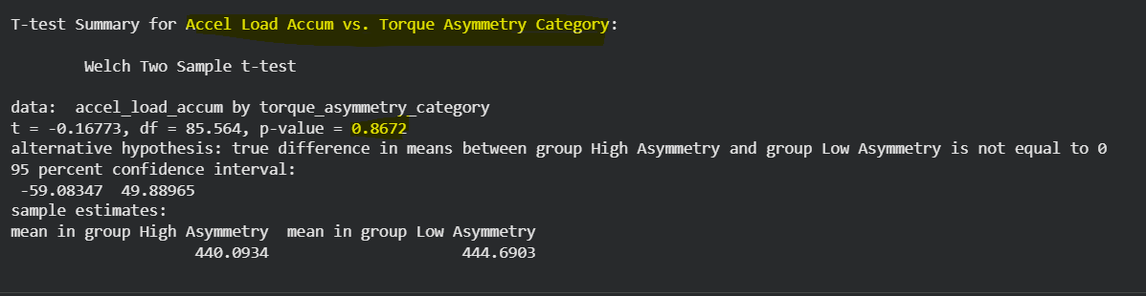
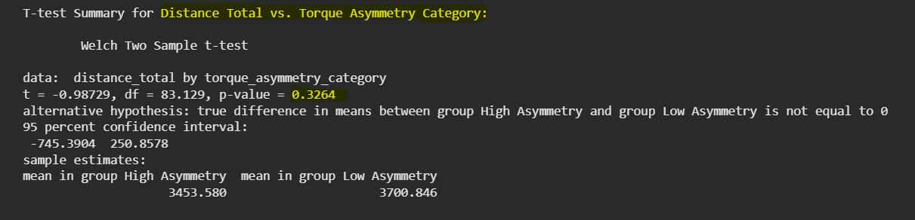
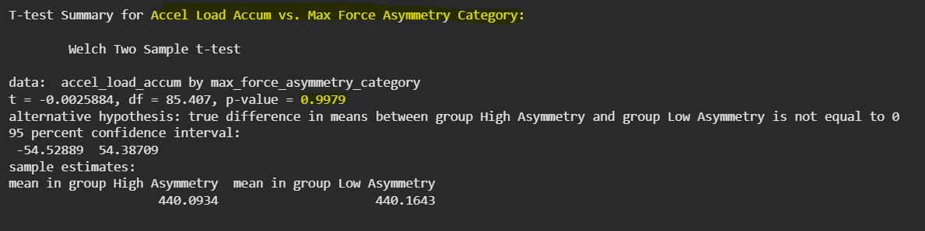
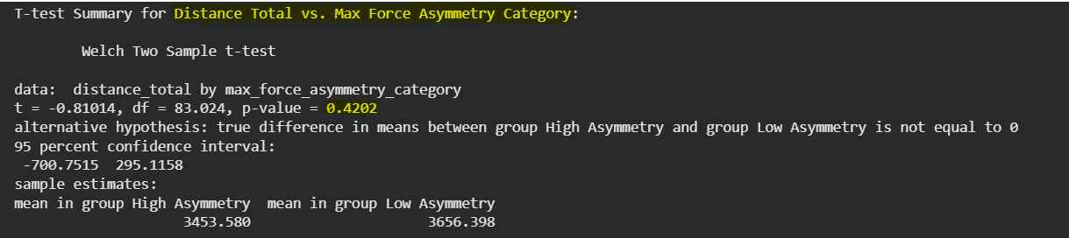
Key Findings
T-test Torque Statistical findings
T-test Results (P-values):
accel_load_accum vs. torque_asymmetry_category: P-value = 0.8672
distance_total vs. torque_asymmetry_category: P-value = 0.3264
accel_load_accum vs. max_force_asymmetry_category: P-value = 0.9979
distance_total vs. max_force_asymmetry_category: P-value = 0.4202
P-value is greater than 0.05
T-test Max Force Statistical findings
https://pmc.ncbi.nlm.nih.gov/articles/PMC8488821/
Notes:
For our statistical analysis
We began with a t-test, using our performance metric as the independent variable (IV) and our categorical metrics as the dependent variable (DV). We chose this initially because we wanted to determine whether asymmetrical categorization affects acceleration load and total distance. However, many of these tests failed, because each category needs at least two levels to perform a valid evaluation.
So we then proceeded with our analysis by treating total distance and accumulated load as our dependent variables (DVs), and our asymmetry category as our independent variable (IV). We also calculated the mean of the asymmetry difference to examine whether there were any significant changes between the two groups.
As you can see our mean values show little to minimal differences between the two categorizations.
with T-test very poor results.
Where our P-value ranging from 0.3264 to 0.9979 all greater than 0.05, and Confidence interval all-inclusive of zero indicates no statistical significant difference.
T-Test Results:
Metric Comparison P-value
Accel Load vs. Torque Asymmetry 0.867
Distance vs. Torque Asymmetry 0.326
Accel Load vs. Max Force Asymmetry 0.998
Distance vs. Max Force Asymmetry 0.420

Slide 12
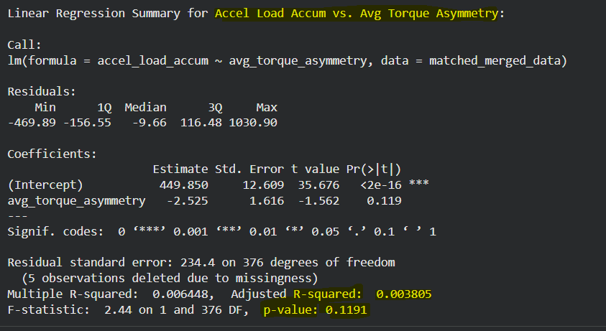
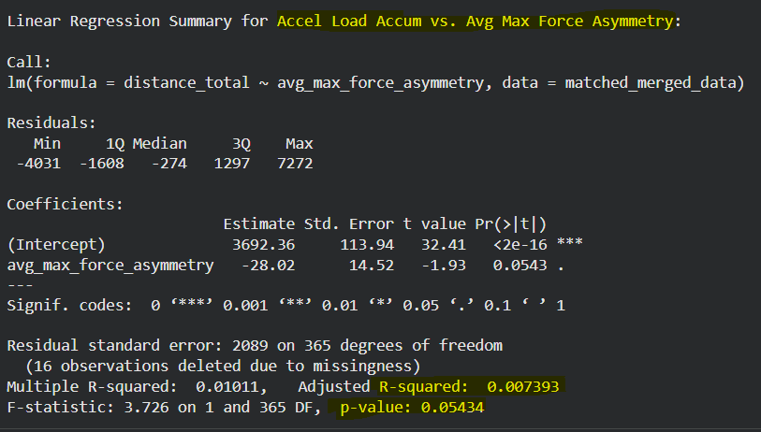
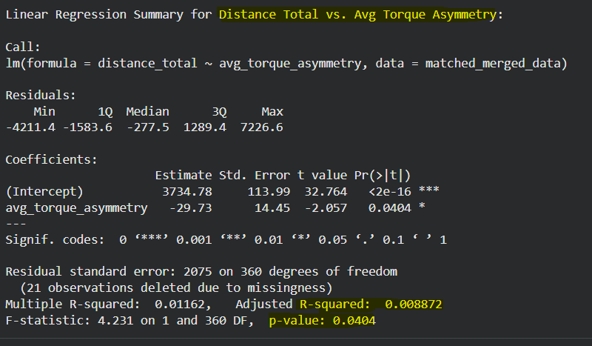
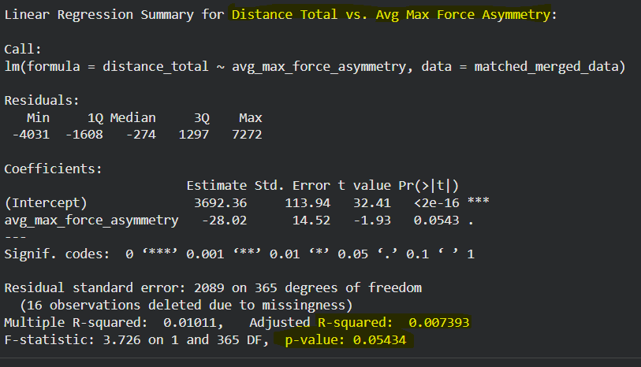
Key Findings
Regression Test Torque Statistical findings
Regression Test Max Force Statistical findings
Linear Regression Results (P-values and R-square values):
accel_load_accum vs.
avg_torque_asymmetry: P-value = 0.1191 ; R-squared = 0.003805
distance_total vs. avg_torque_asymmetry: P-value = 0.0404 ; R-squared = 0.008872
accel_load_accum vs. avg_max_force_asymmetry: P-value = 0.05434 ; R-squared = 0.007393
distance_total vs. avg_max_force_asymmetry: P-value = 0.05434 ; R-squared = 0.007393
P-value is greater than 0.05
R-square lower than 0.3
https://pmc.ncbi.nlm.nih.gov/articles/PMC8488821/
Notes:
Next, we conducted a linear regression to assess whether any of our metrics showed signs of correlation. While some p-values approached 0.05, all R-square values remained very low (much closer to 0 than to 0.30), indicating no meaningful linear correlation could be established.

Slide 13
Key Findings
Comparison to literature
The statistical findings suggest that both torque_asymmetry and max_force_asymmetry have a very limited, if any, linear relationship with accel_load_accum and distance_total in this dataset.
Most p-values for t-tests and linear regressions were not statistically significant, and the adjusted R-squared values were extremely low ranging from (0.002773 to 0.008872).
Overall Average Asymmetrical Torque (avg_asymmetrical_torque): 1.936%
Overall Average Asymmetrical Max Force (avg_asymmetrical_max_force): 1.961%
Notes:
Our literature review indicated athletes with 10-15% asymmetrical difference are at a higher risk of injury.
However the asymmetrical average from our dataset were all less than 2%, this suggests the majority of our participants displayed mild asymmetric symptoms compared to those flagged in our literature review.

Slide 14
Key Findings
Part 1
Comparison to literature
Our literature review indicates asymmetries would negatively impact an athlete's ability to cover distance efficiently or generate acceleration effectively.
However, our data suggests otherwise.
Possible factors that contributed to our weak correlation
Limited data matched players metrics records by date Vald vs Kinexon
Our asymmetrical averages were all less than 2%, our literature review identify groups with 10% or more as high risk, perhaps the majority of the candidates in our dataset may not have symptoms severe enough to affect acceleration and distance performance.
This study does not account for athletes natural abilities to adapt and overcome asymmetrical assessments.
Notes:
Why the discrepancy?
We had to scale down many of our records, from 44,314 to 383 records, due to limited paired data available between bilateral and performance metrics, this reduced our data set to less than 1%.
Perhaps there are other factors contributing to our weak findings.
For example, our study does not account for athletes’ natural abilities to adapt to asymmetrical differences.
Could there be other key indicators we should be reviewing? One of our PubMed sources indicated that higher accumulated load can increase the risk of injury, suggesting that further analysis is needed to determine correlations.

Slide 15
Practical Applications
Part 1
Performance monitoring flag system
Players symmetrical metric standard deviation exceeding 10% to 15% indicating high risk of injury
Players inactivity exceeding 30 days: dig deeper into cause of inactivity
Notes:
Literature:
Asymmetry
https://pmc.ncbi.nlm.nih.gov/articles/PMC8488821/#sec1-5
Inactivity:
https://colab.research.google.com/drive/1pl6wRVZaPeZ0Pbktx6SGiONwlCW_hQ-0#scrollTo=984c2cd3

Slide 16
Practical Applications
Part 1
How our findings fill the identified gap
This will created a personalized injury-risk model that will help players understand their own unique load patterns.
To help better understand force/torque monitoring to manage load-management to protect player fatigue and improve endurance training.
Notes:
Flag system intention:
Players: personalized injury risk model. Identify unique player load patterns
Coaches/trainers: help with player load management. Protect against fatigue, improve endurance
Results:
`1. Small amount of flagged players, but can’t specifically say inc. risk of injury
Rationale:
1. Some players tested more frequently than others. Even if there was high asymmetry, was there enough testing?
2. Lack of data defining reason for lack of testing: Fatigue? Illness? Injury?

Slide 17
Practical Applications
Part 1
Recommendations for coaches/trainers
Identify players with high standard deviation of symmetrical metrics to determine players risk of injury
Monitor active players inactivity to determine whether this is due to injury or impaired abilities from fatigue
Create a regularized screening and testing schedule: One set of bilateral & one non-bilateral simultaneously
Suggest weekly intervals: More data to calculate ACWR: 3-6 weeks of testing
Notes:
Recommendation:
Regular testing (ideally weekly testing) of at least one set of bilateral & one non-bilateral metric simultaneously.
i.e: L/R Torque and/or L/R Max Force (Vald) along with total distance and/or AAL (Kinexon)
Weekly testing = more data for asymmetry and ability to test other inc. injury risk indicators based on literature like the Acute Chronic Workload Ratio

Slide 18
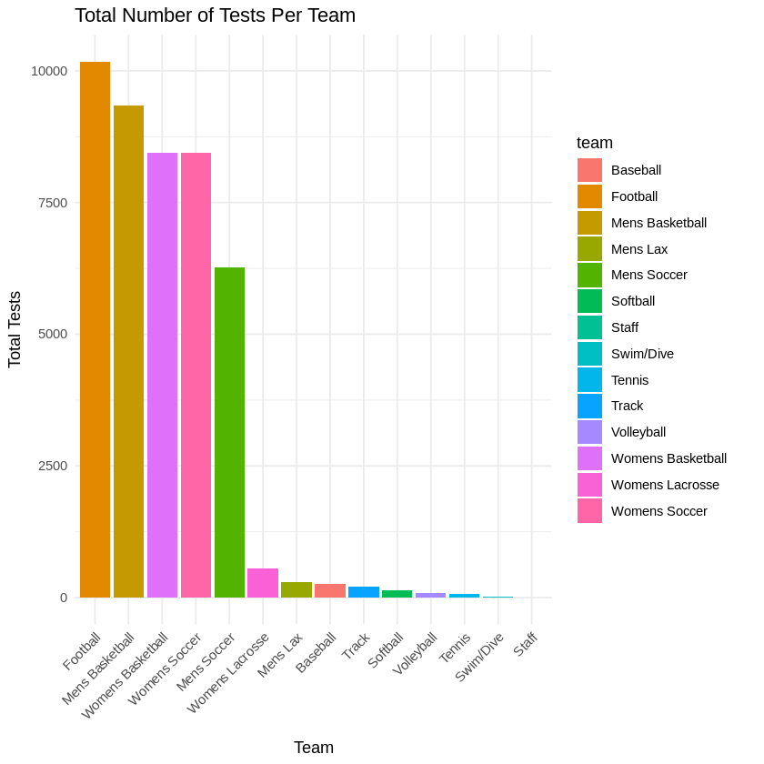
Limitations & Future Work
Data challenges encountered
Duplication of team names and sports (e.g., “Women’s Basketball” vs “Womens Basketball”, “Lacrosse” vs “Lax”)
Entries with missing values
Invalid Team names (e.g., “Unknown”,”Player Not Found”,”Graduated (No longer enrolled) ”)
Difficulty matching symmetrical metric with accumulated acceleration and total distance.
Missing code for athlete is missing data (e.g., injury, sick, unexcused/excused absence, device failure )
Teams would have have lower data outputs compared to other teams
Notes:
So for limitations and future work data challenges that were encountered was, First, we're dealing with inconsistent data entry. Team names appear in multiple formats—"Women's Basketball" versus "Womens Basketball," "Lacrosse" versus "Lax"—making it difficult to agg re gate information accurately. We're also seeing invalid entries like "Unknown" or "Player Not Found," and we lack standardized codes to explain why data is missing. Is an athlete absent due to injury, illness, or equipment failure? Right now, we can't tell.

Slide 19
Limitations & Future Work
Testing challenges encountered
Testing for Bilateral Max Force and torque have inconsistency of both timing and output across multiple teams
Very few teams have developed a regular schedule for Vald device data (Max force and torque)
Testing for Vald data and Kinexon data are recorded as the same day, but different time sessions, for ease of research there needs to be a more concise record.
Notes:
Our testing protocols also need work. Bilateral max force and torque assessments using our Vald devices vary significantly in timing and output across teams. Most programs haven't established regular testing schedules, creating gaps in our longitudinal tracking. Additionally, when Vald and Kinexon data are collected on the same day but during different sessions, it complicates our ability to paint a complete picture of athlete readiness.

Slide 20
Limitations & Future Work
What additional research is needed
Collect more data to determine whether this can serve as a key metric for injury-risk assessment.
Conduct deeper investigation into specific metrics such as max force and acceleration load.
Evaluate injury absences and severity relative to:
  Total distance
  Acceleration load
  Asymmetrical percentages
Calculate weekly workload metrics (e.g., acceleration load, total distance) along with symmetrical force/torque to assess correlations
Notes:
So where do we go from here? We need to expand our dataset to validate whether these metrics can truly predict injury risk. We need deeper investigation into specific measures like max force and acceleration load. Most importantly, we need to examine the relationships between injury events and metrics like total distance, acceleration load, and force asymmetries.

Slide 21
Q & A
Injury prediction in sports is still an evolving field. Beyond the metrics we discussed today—like force, torque, and acceleration load—what other factors do you think should be incorporated into injury risk models to give a more complete picture of an athlete's readiness to compete?

Slide 22
Works Cited
Ashworth, B., Hank, M., Khaiyat, O., Coyles, G., Fallon Verbruggen, F., Zemkova, E., Zahalka, F., & Maly, T. (2025). Early Rate of Force Development and Maximal Strength at Different Positions of the Athletic Shoulder Test in Baseball Players. Sports, 13(9), 300.
García, F., Schelling, X., Castellano, J., Martín-García, A., Pla, F., & Vázquez-Guerrero, J. (2022). Comparison of the most demanding scenarios during different in-season training sessions and official matches in professional basketball players. Biology of Sport, 39(2), 237–244.
Junior, M. N. S. d. O., Veneroso, C. E., Ramos, G. P., Johnson, K. E., Guilkey, J. P., Sena, A. F. d. C., Cabido, C. E. T., & Cholewa, J. M. (2021). Distance and intensity profiles in Division I women's soccer matches across a competitive season. Sports, 9(5), 63.
Koyama, T., Nishikawa, J., Yaguchi, K., Irino, T., & Rikukawa, A. (2024). A comparison of the physical demands generated by playing different opponents in basketball friendly matches. Biology of Sport, 41(2), 527–533.
Nakatani, M., Murata, K., Kanehisa, H., & Takai, Y. (2021). Force-velocity relationship profile of elbow flexors in male gymnasts. PeerJ, 9, e10907.
Prudholme, D. C., Coburn, J. W., Lynn, S. K., & Lockie, R. G. (2022). Relationships between sprint, acceleration, and deceleration metrics with training load in Division I collegiate women's soccer players. Journal of Human Kinetics, 85(1), 53–62.

Slide 23
Works Cited
7. Ruiz-Rios, M., Setuain, I., Cadore, E. L., Izquierdo, M., & Garcia-Tabar, I. (2024). Physical conditioning and functional injury-screening profile of elite female soccer players: a systematic review. International Journal of Sports Physiology and Performance, 19(11), 1355–1366.
8. Şahbat, Y., Kütük, E., Çat, G., Ünsalan, O., Kart, H., Topkar, O. M., Baysal, Ö., & Erol, B. (2022). An unusual injury pattern: arm wrestling injury, treatment modalities, clinical outcomes, and return to sport. Acta Orthopaedica et Traumatologica Turcica, 56(1), 1–6.
9. Schaefer, L. V., Carnarius, F., Dech, S., & Bittmann, F. N. (2023). Repeated measurements of Adaptive Force: Maximal holding capacity differs from other maximal strength parameters and preliminary characteristics for non-professional strength vs. endurance athletes. Frontiers in Physiology, 14, 1020954.
10. Spiering, B. A., Clark, B. C., Schoenfeld, B. J., Foulis, S. A., & Pasiakos, S. M. (2023). Maximizing Strength: The Stimuli and Mediators of Strength Gains and Their Application to Training and Rehabilitation. Journal of Strength and Conditioning Research, 37(4), 919–929.
11. Tavares, N., Vilas-Boas, J. P., & Castro, M. A. (2025). Effect of Preventive Exercise Programs for Swimmer's Shoulder Injury on Rotator Cuff Torque and Balance in Competitive Swimmers: A Randomized Controlled Trial. Healthcare, 13(5), 538.
12. Xiao, M., Nguyen, J. N., Hwang, C. E., & Abrams, G. D. (2021). Increased lower extremity injury risk associated with player load and distance in collegiate women's soccer. The Orthopaedic Journal of Sports Medicine, 9(10), 23259671211048248.

